Slide 1
Gender of Voice Detection using Machine Learning
Hui Zheng (hz1436)

Slide 2
Introduction
Gender of voice detection is a classical example in machine learning
The human ear can easily identify a person’s gender within the first few spoken words, but it is tricky to design a computer program that can detect the gender
The goal of this project is to implement multiple models using python to determine a person’s gender as male or female based on a sample of their voices

Slide 3
The Dataset
The dataset was built using thousands of samples using male and female voices.
Each voice sample is stored as a .WAV file, which is then pre-processed for acoustic analysis
The pre-processed .WAV files were save into a CSV file (20 columns for each feature and one label column)
The dataset can be downloaded below:
https://raw.githubusercontent.com/primaryobjects/voice-gender/master/voice.csv

Slide 4
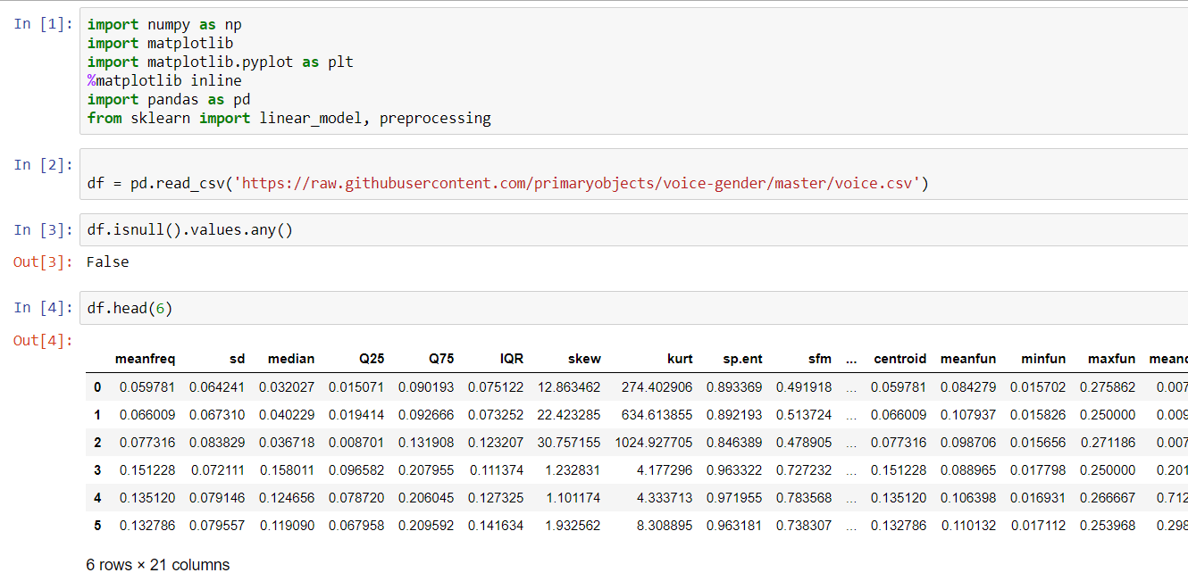
Data Visualization
Load the dataset
Check if there is any missing value
Visualize the first six rows

Slide 5
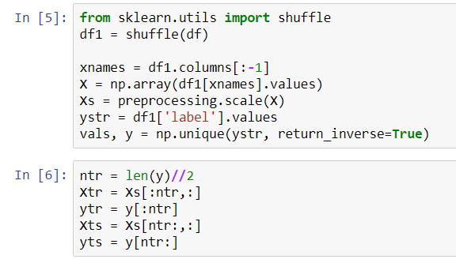
Data Processing
Process the data for analysis
Scale X
Convert labels into values
Split the data into training set and test set

Slide 6
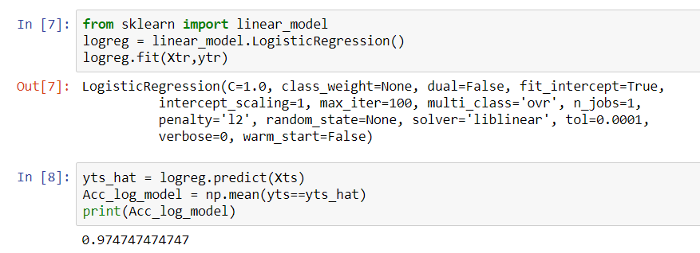
Logistic Regression Model
The logistic regression model is able to achieve accuracy around 97%

Slide 7
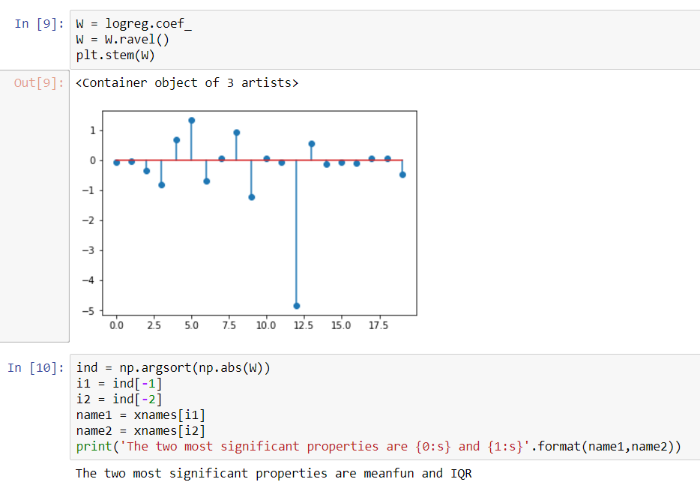
Feature Selection
Weights were extracted from the logistic model
The two most significant features are “meanfun” and “IQR” among the 20 features

Slide 8
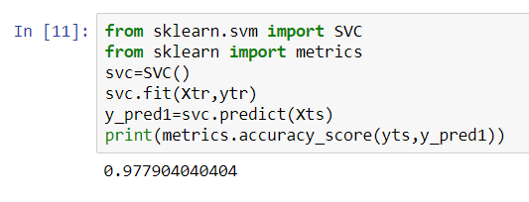
SVC Model
C-Support Vector Classification
This model is able to achieve an accuracy around 98%

Slide 9
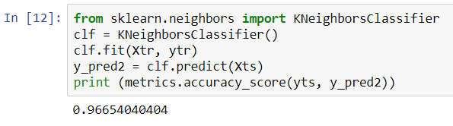
KNeighborsClassifier
Classifier implementing the k-nearest neighbors vote
The accuracy of this model is around 96% (Slightly worse than the SVC model

Slide 10
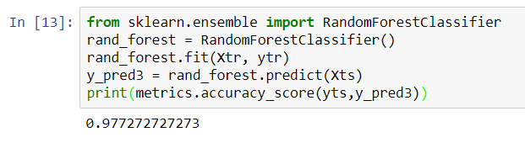
Random Forest Model
This model is able to achieve approximately 98% accuracy

Slide 11
Reference
K. Becker, "Identifying the Gender of a Voice using Machine Learning", Primary Objects, 2017. [Online]. Available: http://www.primaryobjects.com/2016/06/22/identifying-the-gender-of-a-voice-using-machine-learning/. [Accessed: 12- Dec- 2017].

